Slide 1


HEALTH FOR HUMANKIND
VITALITY WATCHER
Live worry-free. Our app watches over your health, even when you're dreaming.

Slide 2

TABLE OF
CONTENTS
01
02
03
04
Theme
Who we are
Major Problems
Problem we chose
05
06
07
08
Why this specific problem
Proposed Solutions
Selected Solution and Reason
Prototype

Slide 3

WHY WE CHOSE
MED TECH
Med tech allowed us to envision a transformative future where technology fuels personalized, accessible healthcare.
Where we pioneer innovations merging empathy and advancement, empowering individuals to own their well-being.
Also, it has a good number of startups and businesses which would help us understand the field better.

Slide 4



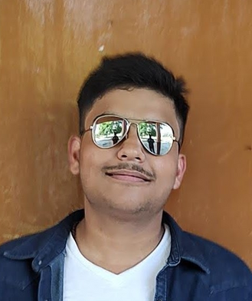
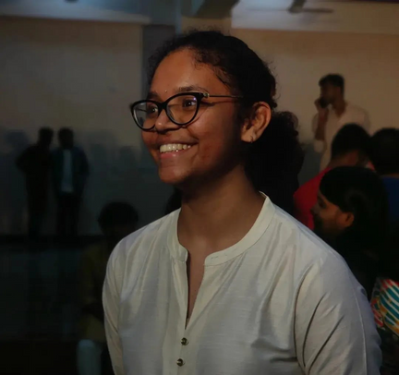
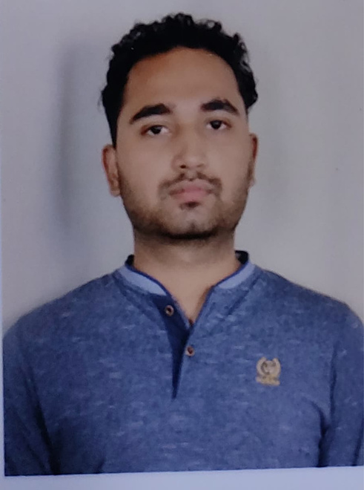
MEET
THE TEAM
Abhinav
Aditi
Padmaksh
Varsha
Vineet
We are a team of five college students specializing in Computer Science and Engineering (CSE), Engineering Physics (EP) and Chemical Engineering (CB)
Our diverse backgrounds unite in a shared mission to innovate within the healthcare sector. Leveraging our interdisciplinary skills, we aim to pioneer engineering-driven solutions for proactive health management.

Slide 5
PROPOSED
PROBLEMS
A way to discreetly hint individuals about their current health status, in order to mitigate negligence and proactively prevent lifestyle disorders.
A way to ensure accessible, ethically priced organs and blood for patients in order to improve affordability and save lives.
A method to detect mallet finger injuries in athletes, enabling determination of severity for informed decisions on seeking medical attention.
A way to target and sell insurance to customers for banks in order to maximize gains.

Slide 6

THE FINAL
PROBLEM
A way to discreetly hint individuals about their current health status, in order to mitigate negligence and proactively prevent lifestyle disorders.
Family Bond: A loving family with a dedicated father and a caring daughter.
Daily Routine: The little girl waking her dad up every morning, until one day, she couldn't.
Tragic Loss: The father's unexpected passing due to an undiagnosed health issue during sleep.
Realization: The family discovers that subtle hints about his health could have made a difference.
Prompt for Intervention: What all needed was just a hint an indication.
Here's where our solution steps in. We offer discreet health alerts, aiming to prevent tragedies by gently nudging individuals toward proactive healthcare actions.
Our vision? Saving lives and fostering healthier futures by giving them the hint they needed.

Slide 7
WHY THIS
PROBLEM ?
Does solution exists?- Yes
Is there any government intervention? - No
Market size? - 20-50 yr age group(which includes 1.1 crore obese people and also the number of annual CVD deaths has doubled in last decade to 5 million in India)
Is there any competition? - Yes
Personal interest - Yes
Will go through both B2B and B2C? - Yes

Slide 8
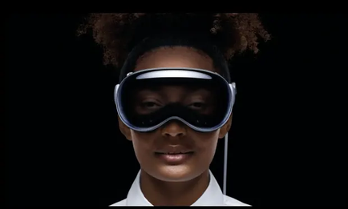
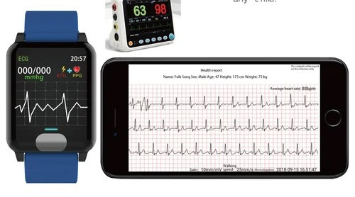
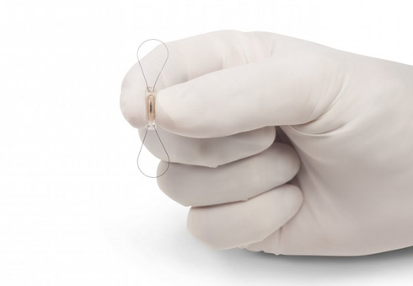

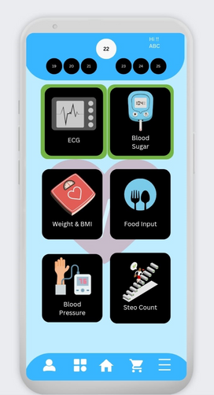

OUR
SOLUTIONS
VR for stress management
Fitness watch with ECG sensor
Microchip implant
Heart health based app
Changing into healthy lifestyle

Slide 9

SELECTED
SOLUTION
Vitality Watcher
A discreet health monitoring system using smartwatch sensors and user-input data to gently alert individuals about their health status, mitigating negligence and proactively preventing lifestyle disorders. An integration with watch which can measure ECG or Troponin level detector helps in active and early detection of heart attack or atrial fibrillation or other life-taking situations

Slide 10
WHY THIS
INNOVATION ?
Reducing the number of lives lost due to Heart attacks or other lifestyle diseases.
Constant and active tracking of the health parameters of user/patient can help finding major health risks earlier.
This solution is easy to use, efficient, and also helps in leading a healthy life. The user will be always aware of his situation which can help them stay healthy&fit.

Slide 11
SOLUTION
FILTER
Unique? - Yes. Some parts are Implemented by other competitors. Our main objective is to detect vulnerability factor of a person through a new sensing system to measure troponin(TI) level actively through an optical system. Initial model will have ECG system which will be replaced later integrated with ML algorithms.
Skill gap? - Yes. ML engineers to implement all recorded factors on app to make an algorithm for predicting vulnerability score. Implementation of Optics-based troponin system in a watch requires a well-abled R&D Team.
Tech feasibility? - Yes. Required sensors (ECG, heart rate, steps etc.) are available.
BOM of the product= MRP/10 = ₹480(Excluding the development of a new TI-Sensor)

Slide 12
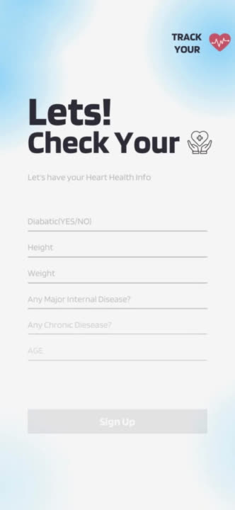
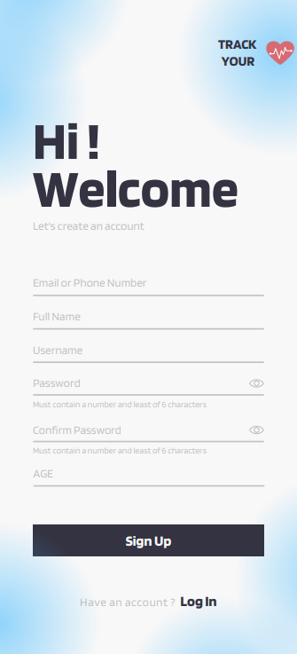
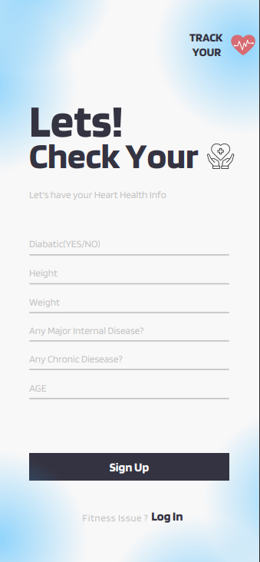
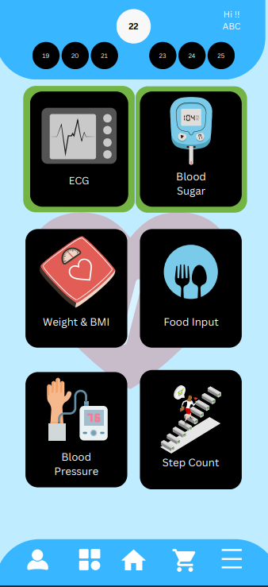
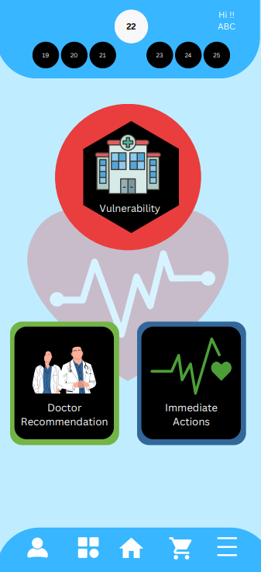
PROTOTYPE
APP

Slide 13
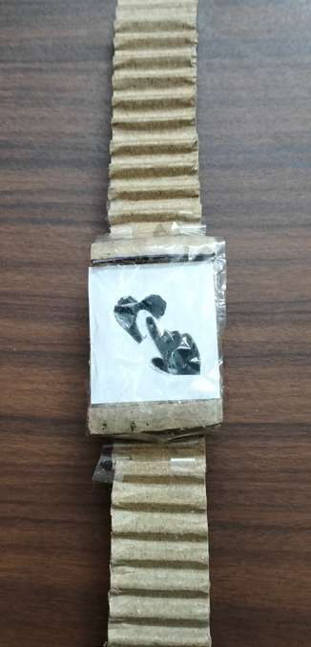
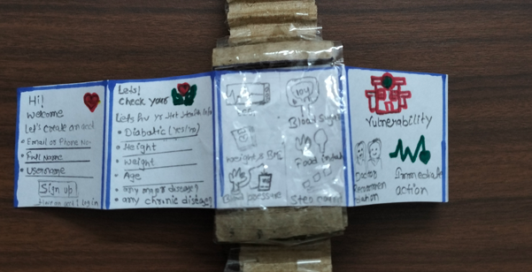
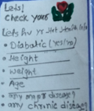
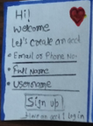
PROTOTYPE
INTERFACE OF SMARTWATCH

Slide 14
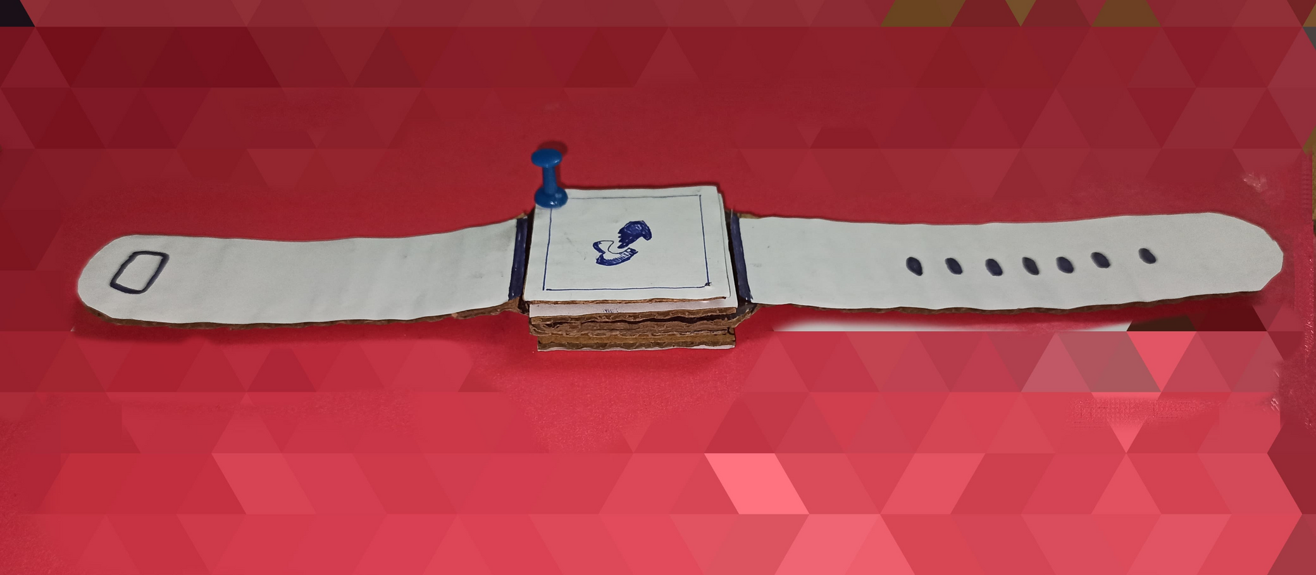

Structural Prototype
Smartwatch

Slide 15
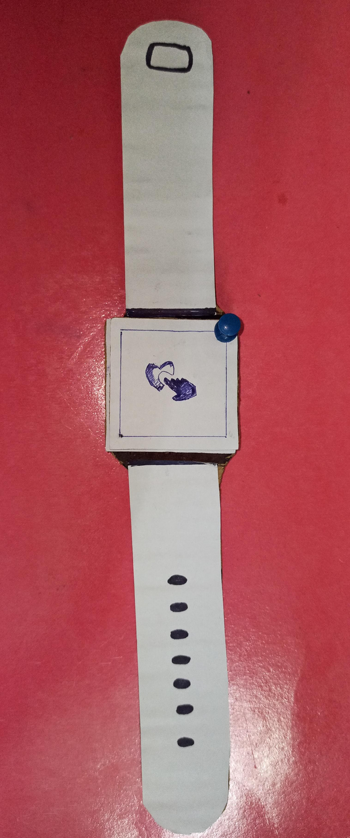
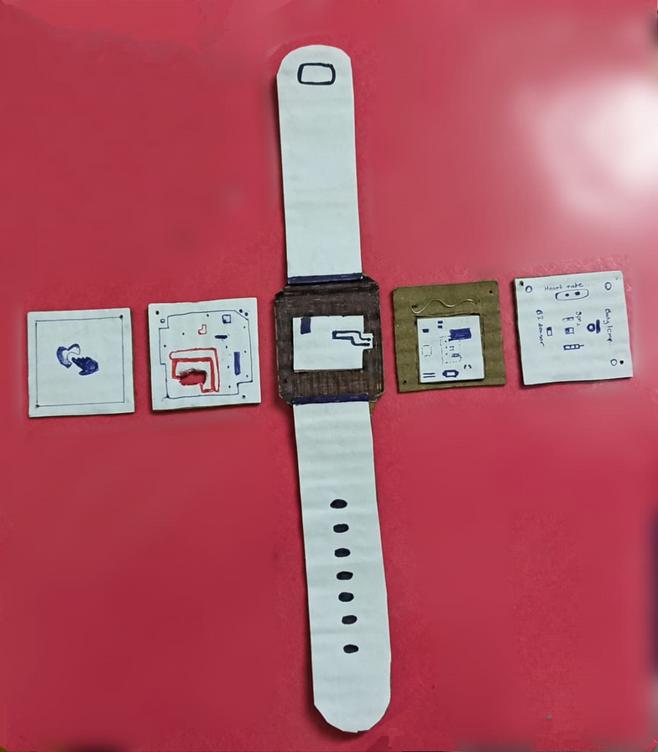
Top view
Layers of the watch

Slide 16
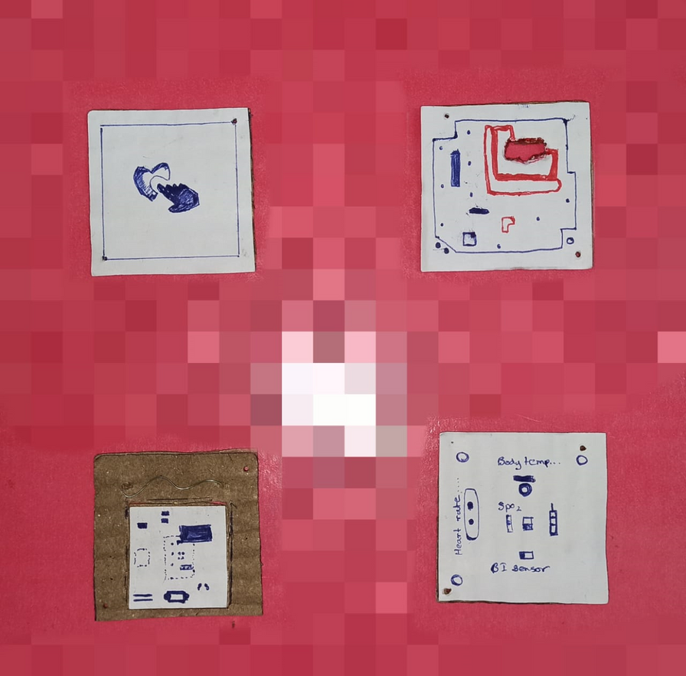
Each layers
Front screen
Circuit layer
1)First layer will contain a touchscreen and a Ambient light sensor embedded
2)Circuit layer will integrate all the inputs and output and also process the data
3)ECG Layer will helps in ECG measurement of the user. This layer can be replaced by a troponin detection system
4)Back side will cover the system also allow sensors to interact with user
ECG Layer
Back side
Each layers

Slide 17
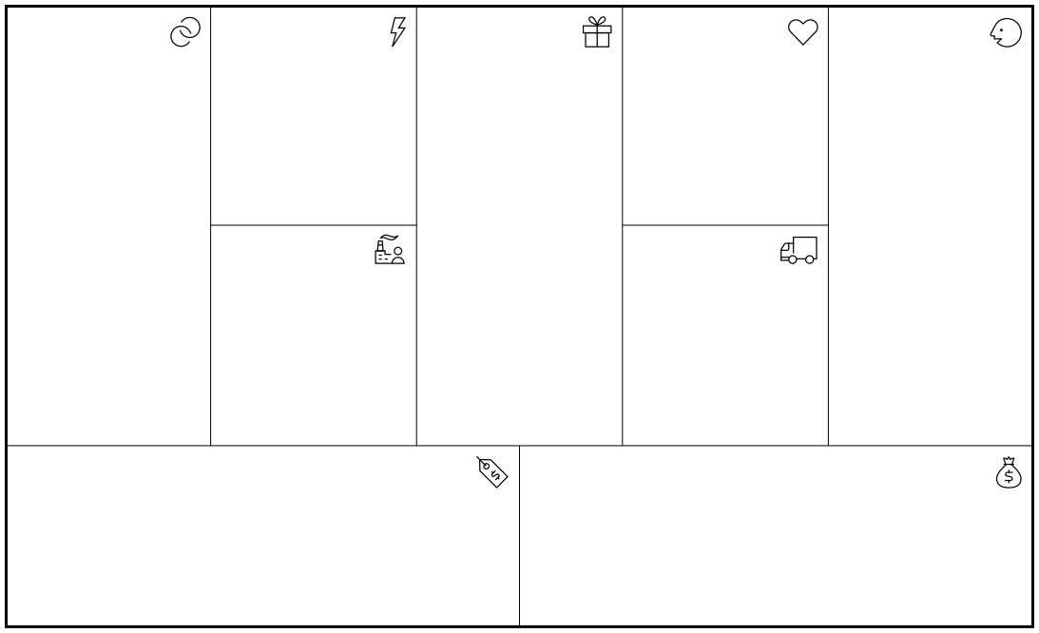
Key Partnerships
Key Activities
Value Propositions
Customer Relationships
Customer Segments
Healthcare providers
IT companies
Gyms & Yoga instructors
Research
Medical Collaboration
Data collection & integration
Algorithm development
Watch & App development & testing
Continuous improvement
Empowering proactive health management with comprehensive real-time monitoring, analysis, and personalized recommendations for optimal heart health.
Predictive insights to enhance well-being, minimize risks, and connect users with tailored medical expertise
Personalized feedback
Community engagement
Responsive assistance
Continuous support
User education
Health awareness events and competitions
Heart patients (known)
Sports persons and athletes
Health enthusiasts
Corporate wellness programs
Diabetic patients and people with high cholestrol levels.
Healthcare providers
Key Resources
Channels
Development & medical team
Cloud services
Funding
Partners
Patents and Licenses
Health database
Sports academy
Social Media
Ads
Pharmacies and hospitals
Online ads and marketing
Cost Structure
Revenue Streams
Hiring backend programming of app and watch
Infrastructure
Hiring price for employees and researchers
Marketing cost
Watch & App publishing cost
6. Maintenance cost
7. Health experts
8.Commission for other markets
9.Compliance and Legal
Yearly/ Monthly subscription plans
Plans for companies
Healthcare personalized plans
Non-premium version with Ads
Collaboration with fitness industries (gym, sports academy)

Slide 18


MED TECH
THANK YOU

